Slide 1
Claude Connectors
6 MONTH AI SERIES · SESSION 3
STANDARD CO
Connecting Claude to Your Tools
Jonathan Nesbitt & TJ Muehleman | May 28, 2026

Slide 2
Where we’ve been
RECAP
STANDARD CO
MARCH
APRIL
MAY
Session 1
Session 2
Session 3
Claude Code + Cowork
CLAUDE.md + ./claude/
Connectors
Met Claude. Learned the interface.
Gave Claude lasting project context.
Let Claude reach your tools.

Slide 3
MCP vs Connectors
Anthropic's analogy: MCP is a USB-C port for AI applications. An MCP provides a single, standardized way for different AI models to connect to diverse data sources and tools.
THE STANDARD
THE IMPLEMENTATION
MCP
Connectors
Model Context Protocol
MCP servers for specific tools
An open standard from Anthropic that defines how AI applications talk to external systems — the protocol everyone builds against.
Concrete MCP servers — one per tool — that let Claude read from and write to Notion, Slack, GitHub, your internal systems, etc.
You don't "use" MCP directly. You use connectors built on it.
This is what you install, configure, and click "Connect" on.
→ MCP is the spec. Connectors are how you actually plug Claude into your stack.

Slide 4
Claude is powerful, but isolated
THE PROBLEM
STANDARD CO
Notion
Slack
Google Drive
Claude
can only see what you paste in
✕ ✕ ✕
no connection
GitHub
Help Scout
Databases
Every copy-paste is integration work you’re doing by hand.

Slide 5
Connectors let Claude use your tools directly
WHAT ARE CONNECTORS
STANDARD CO
Claude
Connector
External tool Notion, Slack, GitHub…
→ Claude reads from and writes to external tools
→ Built on MCP (Model Context Protocol) — an open standard
→ 200+ pre-built connectors in the directory
→ Build custom connectors for your internal tools

Slide 6
Available everywhere Claude runs
WHERE THEY RUN
STANDARD CO
Same protocol, four surfaces. Setup differs slightly; the concept is the same.
Claude.ai (Web)
Claude Desktop
Built-in Connectors Directory — toggle on from settings
Connectors + Extensions for local MCP servers
Claude Code
Claude API
Configure per-project in .claude/settings.json or user
MCP Connector parameter for programmatic agents

Slide 7
Setup once, then use every day
HOW WE ACTUALLY USE THEM
ONE-TIME
EVERY DAY
Setup
Daily use
Team Leaders configure connectors in our Cowork workspace
Notion, Slack, QuickBooks — authenticated once, scoped to the team
Every Cowork session now has access
The whole team, in every Claude session
Read context, do the work, write results back through the same connector
Claude participates in the workflow — no copy-paste handoff
IN PRACTICE — NOTION CONNECTOR
Claude pulls open tasks from Notion → does the work → updates task status back in Notion. One connector, both directions, no manual handoff.

Slide 8
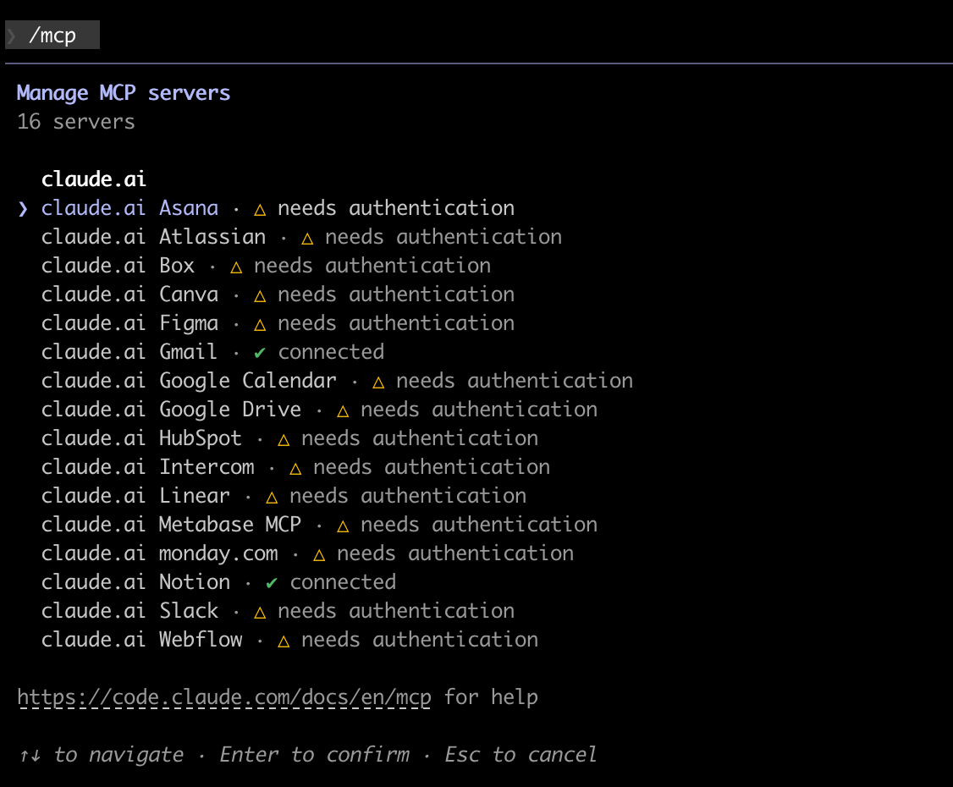
KNOW WHAT'S CONNECTED
STANDARD CO
Run /mcp to see what's wired up
One command in Claude Code lists every MCP server it can reach — and what level it's coming from.
Every server, at a glance
Each row shows a connector and its state — ✓ connected or ⚠ needs authentication. Here, Gmail and Notion are live; the rest are toggled on but unauthenticated.
The source tells you the scope
Every server here is prefixed claude.ai — meaning account-level. They follow my sign-in across machines. Local servers would show up under a different source label.
Use it before you debug
When a tool call "doesn't work," run /mcp first. Nine times out of ten the connector is either not authenticated or not connected at the level you thought.
→ If it's not in /mcp, Claude can't reach it. Start there.

Slide 9
What can you actually do with this?
USE CASES
STANDARD CO
Four categories where connectors pay off immediately for our team.
DOCS & KNOWLEDGE
CODE
Notion as context
GitHub + Claude Cowork
Pull wiki pages, project docs, and meeting notes into Claude with full context — no copy-paste.
Review PRs, triage issues, and pair with Cowork on changes — all grounded in the actual repo state.
CHAT
INTERNAL TOOLS
Slack history
Custom connectors
Search threads, summarize long conversations, and draft replies grounded in real context.
Bridge Claude to your own APIs, dashboards, and databases via the MCP SDK.

Slide 10
Let’s see it in action
DEMOS
STANDARD CO
Two live demos. The first reads and writes. The second chains tools together.
01
02
Notion Connector
End-to-end workflow
Claude reads task data from our Notion workspace, then updates a card’s status — live, from Claude Code.
Connect a second source, chain tools, complete a real task: doc → task → Slack summary.

Slide 11
Notion Connector
DEMO 01
STANDARD CO
Claude Code reads tasks from our workspace and writes status back.
LIVE DEMO
1
Pull task list
2
Update a status
3
Verify in Notion
Claude reads Notion page structure
Claude writes back to the card
Change appears in the workspace

Slide 12
Claude × Help Scout
DEMO 02
STANDARD CO
TJ walks through Claude reading and acting on live Help Scout tickets.
LIVE DEMO
Help Scout
Read tickets
Do the work
Write it back
Ask Claude a question in plain English
Claude pulls tickets, threads, customers
Triage, draft a reply, summarize
Post a note, export to Sheets, hand off

Slide 13
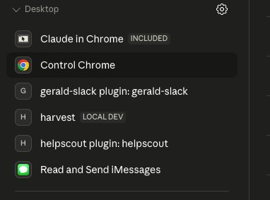
Local MCPs live on this machine
LOCAL MCPS
STANDARD CO
My other Mac’s Claude Desktop sidebar. Same account, signed in here too — but none of this shows up.
Configured per machine
Each one lives in claude_desktop_config.json or as a Desktop plugin on this specific computer.
Doesn’t sync with your account
Account-level remote connectors follow you across devices. Local servers and Desktop plugins don’t — that’s why this list is empty on a second Mac.
Best for machine-bound or in-progress work
OS-specific tools (iMessage), browser control, dev servers (the LOCAL DEV badge), or anything you’re still building.
Claude Desktop › Connectors panel, my work Mac
→ Want it to follow you everywhere? Rewrite it as a remote MCP server — then it becomes account-level.

Slide 14
Marketplace vs Custom Connectors
Two paths to plug Claude into your stack: grab one off the shelf, or build your own when the connector you need doesn’t exist yet.
OFF THE SHELF
BUILD YOUR OWN
Marketplace
Custom
Anthropic & partners
Your tools, your APIs
Pre-built connectors for the tools most teams already use — Notion, Gmail, Slack, Google Drive, Figma. Browse the directory, toggle on, authorize.
Point Claude at any remote MCP server URL — internal tools, niche apps, anything not in the marketplace yet. You bring the server, Claude brings the model.
Click to connect. No code required.
Paste a URL. Only connect servers you trust.
→ Start with the marketplace for speed. Reach for custom when no one’s built the connector you need yet.

Slide 15
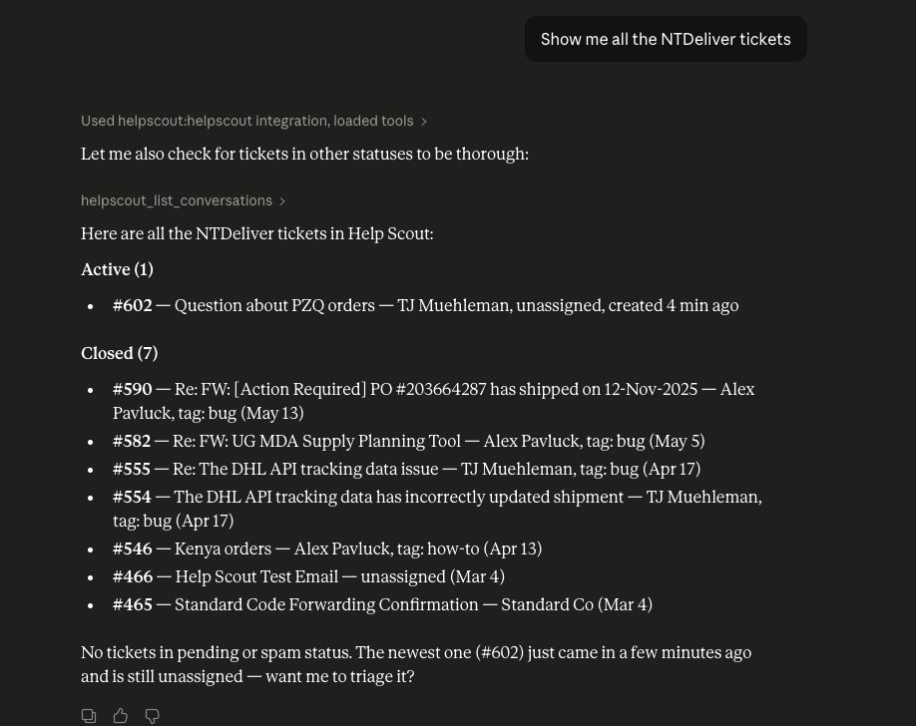
Read: fetch tickets from Help Scout
DEMO 03 · STEP 1 OF 3
STANDARD CO
One prompt, every ticket in the mailbox — no API code, no copy-paste.
THE PROMPT
“Show me all the NTDeliver tickets”
WHAT CLAUDE DID
Recognized “tickets” meant Help Scout. Called helpscout_list_conversations across statuses, returned 1 active + 7 closed with ticket #, subject, assignee, and timestamps.
WHY IT MATTERS
This is the most fundamental connector pattern. Ask in plain English → structured data back. Same flow works for Notion pages, Slack threads, QuickBooks invoices, anything else you connect.
→ Step 1: read. Next we’ll write back.

Slide 16
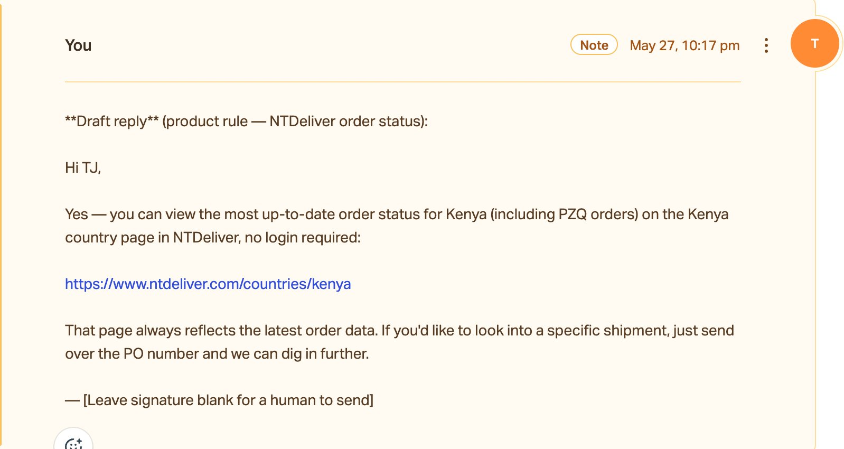
Write: leave a draft reply on the ticket
DEMO 03 · STEP 2 OF 3
STANDARD CO
Claude doesn’t just read — it acts. Drafted a reply and posted it as a private note on the ticket.
THE PROMPT
“Draft a reply on the PZQ ticket using our standard order-status response.”
WHAT CLAUDE DID
Composed the reply using our product rule, then called Help Scout’s create-note action. The note shows up directly on the ticket, ready for a human to send.
WHY IT MATTERS
Connectors are two-way. Claude can change state in the systems you connect — create, update, comment — not just read.
→ Read + write covers most workflows. Next: chain two connectors together.

Slide 17
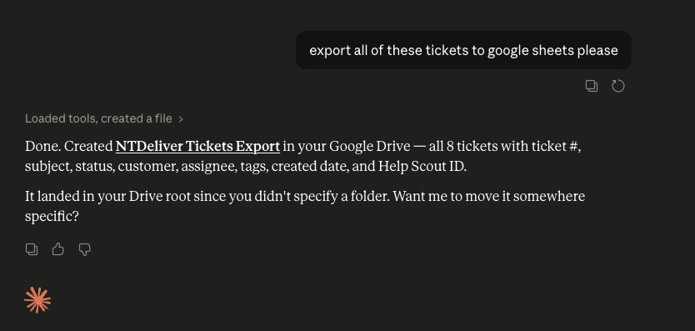
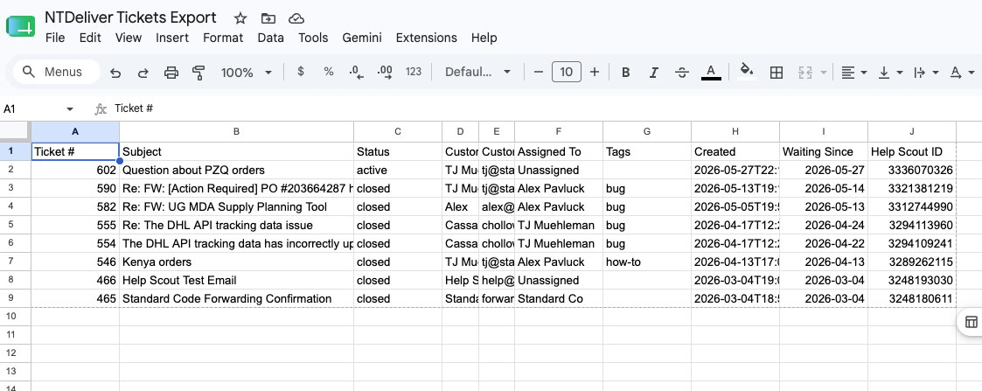
Chain: Help Scout × Google Sheets
DEMO 03 · STEP 3 OF 3
STANDARD CO
One prompt, two connectors. Claude pulls every ticket from Help Scout and spins up a structured export in Google Sheets.
1 · IN CLAUDE
2 · IN GOOGLE SHEETS
TOOLS USED · helpscout.list_conversations → gdrive.create_file
Claude held the ticket data from step 1 in context, then handed it to the Drive connector to write a fresh spreadsheet — ticket #, subject, status, customer, assignee, tags, dates, Help Scout ID.
→ The compounding move. Every new connector multiplies what the others can do.

Slide 18
DATABASES
STANDARD CO
Database MCPs: useful, but not the default
For most local dev, Claude Code + the CLI is faster. Reach for an MCP when you get something concrete back.
THE DEFAULT
WHEN MCP EARNS ITS KEEP
CLI + connection string
Database MCP server
Claude Code runs psql, mysql, sqlite3 directly against your DATABASE_URL.
A server (Postgres, Snowflake, BigQuery, etc.) exposes list_tables, describe_table, read_query.
→ Zero setup — if it's on your PATH, it works
→ Schema introspection as a structured tool call
→ Claude knows SQL + these tools cold
→ Warehouses without a nice CLI (Snowflake, BigQuery)
→ Composes with bash: pipe, redirect, grep
→ Multiple DBs in one session, cleanly named
→ Read-only role on the DB = your real safety net
→ Available in Claude.ai, not just Claude Code
→ Start with the CLI. Add a DB MCP when introspection, warehouses, or Claude.ai access actually buy you something.

Slide 19
Connectors are permission-aware
SAFETY & PERMISSIONS
STANDARD CO
You decide what Claude can see, what it can do, and when to confirm before it acts.
01
02
03
Scoped access
Least privilege
User control
Each connector only sees what you approve. A Notion connector doesn’t get your whole workspace — you scope it to specific pages or databases.
Grant only the permissions the task actually needs. If Claude just reads tickets, don’t give it write access.
For sensitive actions — deletes, public posts, anything destructive — Claude asks before executing. You stay in the loop.
Tip: your CLAUDE.md from Session 2 can carry rules about which connectors are allowed where.

Slide 20
Try it this week
GETTING STARTED
STANDARD CO
Connect at least one tool. Pick the path that matches how you work.
EASIEST
Claude.ai / Desktop
Settings › Connectors › browse the directory › toggle on › authorize.
PROJECT
Claude Code
Add connector config to .claude/settings.json (per-project) or your user settings.
CUSTOM
Build your own
Use the MCP SDK to connect Claude to an internal tool that doesn’t have a connector yet.

Slide 21
Coming up in the series
WHAT’S NEXT
STANDARD CO
Three more sessions. Each builds on what we’ve covered so far.
JUNE · SESSION 4
JULY · SESSION 5
AUGUST · SESSION 6
Building a Claude Agent
GitHub & deployments
Chrome, cloud & sharing
How Standard Co built an agent for customer success — humans in the loop, a real case study from our own work.
Workflow integrations: pull requests, deployments, release notes — Claude across the dev lifecycle.
Chrome extension, AWS/Azure integrations, and sharing context across a team. Series wrap-up.

Slide 22
Questions?
SESSION 3 · MAY 28, 2026
STANDARD CO
Security, custom connectors, cost, where to start — anything.

